Slide 1
ONBOARD OPTIMAL TRAJECTORY DESIGN FOR A DIFFERENTIAL DRIVE UNMANNED GROUND VEHICLE

Slide 2
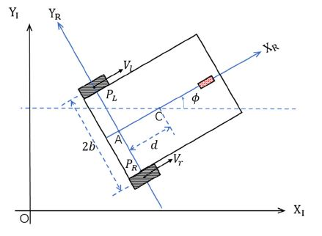
KINEMATICS AND DYNAMICS
C : The center of mass point
A : The mid-point of the rear axle
b : The half distance between two driven wheels
d : The distance between point C and A
r : The radius of the driven wheel
φ : The orientation in the inertial frame
θr : The angular position of the right wheel
θl : The angular position of the left wheel

Slide 3

The system can be transformed into a state-constrained double integrator dynamic system:
$$\begin{aligned}&\dot{q}=\hat{S}(q)v \\ &\dot{v}=u\end{aligned}$$
$q=[x,y,∣φ]^{T} and v=[v,ω]^{T}, we define x=[q,v]^{T}$
$$\hat{S}(q)=\left[\begin{matrix}cos⁡φ & −dsin⁡φ \\ sin⁡φ & dcos⁡φ \\ 0 & 1\end{matrix}\right]$$

Slide 4

PROBLEM FORMULATION
Pseudo spectral method – (Chebyshevs ) with CGL nodes.
Minimize J=t_f
Subjected to :
boundary conditions :
$$x\left(t_{0}\right)=x_{0},x\left(t_{f}\right)=x_{f}$$
control constraints :
$u_{min}≤u≤u_{max}$
state constraints :
$$x_{min}≤x≤x_{max}$$
nonlinear constraints :
$$\begin{aligned}&\dot{q}=\hat{S}(q)v \\ &\dot{v}=u\end{aligned}$$

